Slide 1
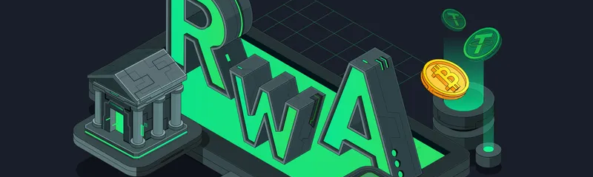
Real-World Assets Tokenization
RWA Tokenization Platform
Secure, Compliant, Production-Ready Architecture for Real-World Assets

Slide 2
01
02
03
04
05
06
07
08
09
08
Table of contents
09
10
Project overview
Current Situation
Vision & Mission
Architecture Design
Smart Contract Design
Compliance Model
Key Design Decisions
Security Framework
Data
Privacy
Risks & Challenges
Project Summary
Q&A

Slide 3
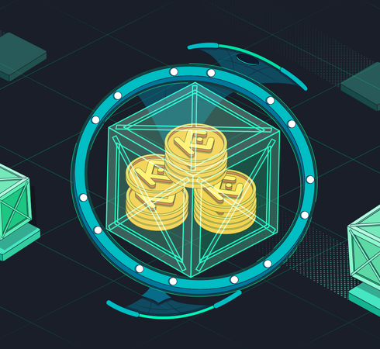
Project Overview
RWA Tokenization Platform
Bridging Traditional Finance with Blockchain Technology
Project Scope:
Tokenization of Real-World Assets (Real Estate, Private Credit, Funds)
On-chain compliance enforcement
Secondary market infrastructure
Institutional-grade security
Key Features:
✅ Fractional ownership through ERC-20 tokens
✅ Automated regulatory compliance
✅ Multi-signature administration
✅ Hybrid custody model (MPC + self-custody)

Slide 4
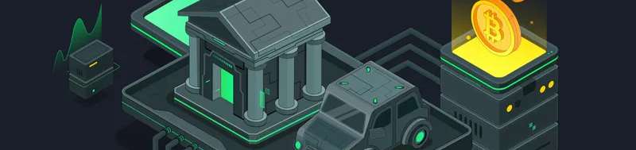
Current Situation
Market Problems:
Liquidity: Assets locked for years
High Minimums: $50K+ investments required
Manual Processes: Slow, expensive operations
Limited Access: Geographic restrictions
Opacity: No transparent pricing
Opportunity: $16T+ addressable RWA market

Slide 5
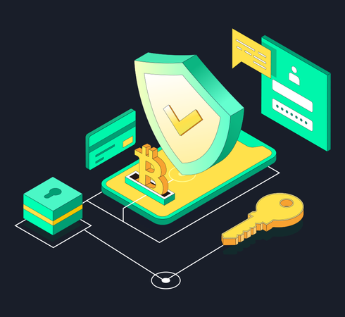
Vision & Mission
Vision: Democratize institutional investment access via blockchain
Three Core Principles: Security First - Multi-layered protection, Compliance by Design - Regulations embedded in code, Investor Protection - Capital preservation mechanisms
Mission: Build secure, compliant platform
Tokenizes assets efficiently, Embeds regulations in code, Protects investor capital, Scales globally.

Slide 6
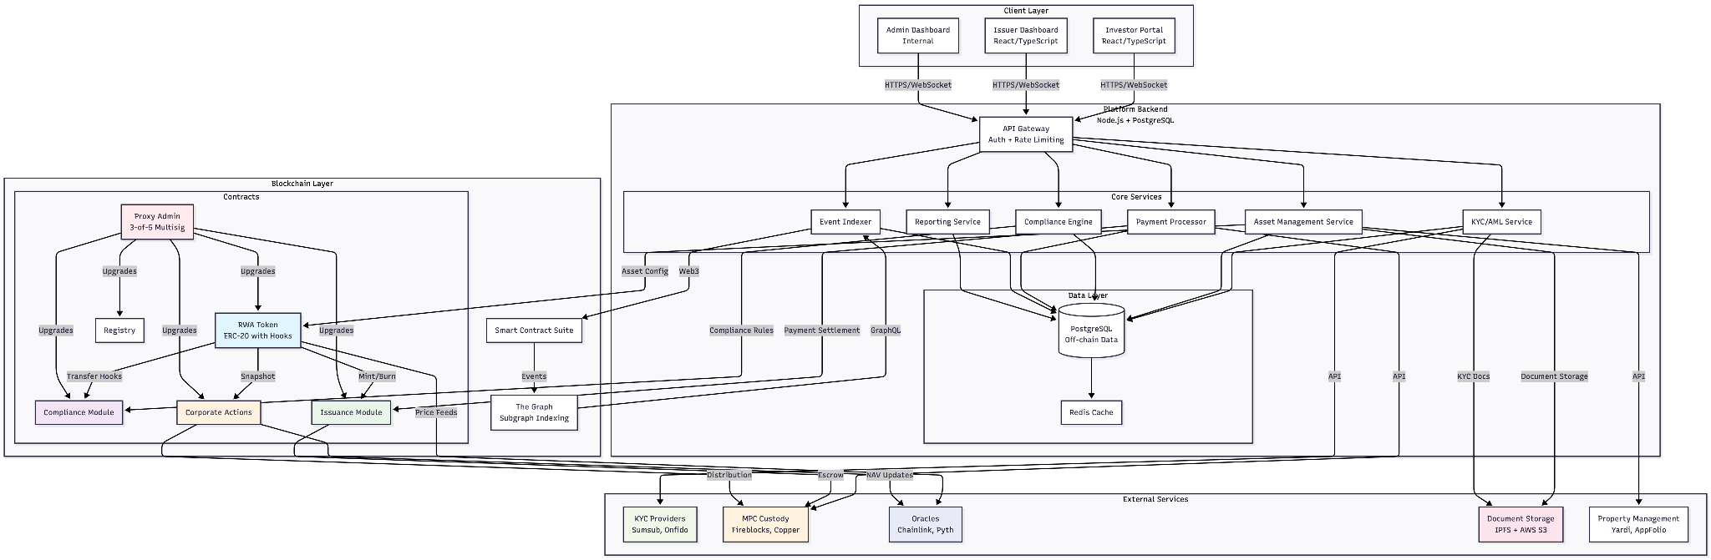
Design Architecture

Slide 7
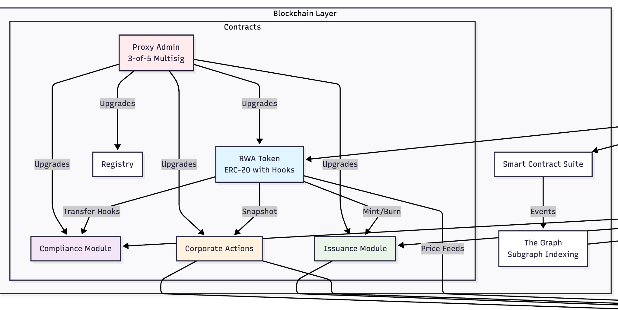
Architecture Part - I

Slide 8
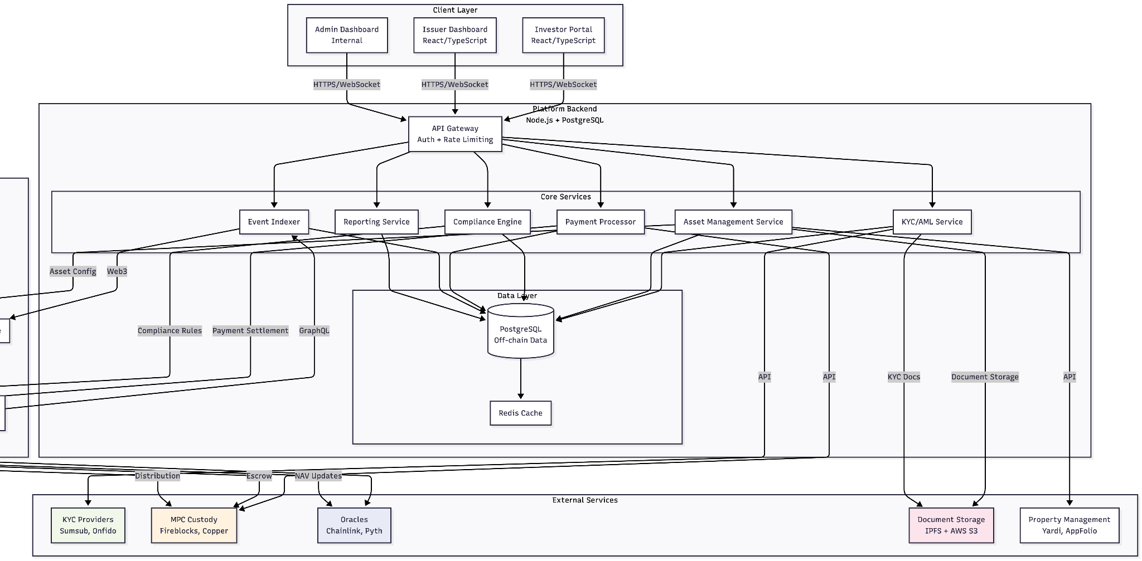
Architecture Part - II

Slide 9
Smart Contract Design
Modular Architecture:
RWA Token (ERC-20 with hooks)
Compliance Module
Issuance Module
Corporate Actions & Registry
01
02
03
04
ERC-20 with ERC-1400/ERC-3643-like feature. Most common for fractional ownership, supports compliance hooks.
On-chain allowlist + modular compliance contract. Ensures enforcement at contract level, not just backend.
Primary market sales ( Issuer → Platform → Due Diligence → Contract Deployment → Token Minting )
Dividends and redemptions.
Asset and investor management

Slide 10
01
02
03
Compliance Model
On-Chain Enforcement:
Off-Chain Verification
Compliance Features
Transfer restrictions at contract level. Allowlist validation before any transaction. Jurisdiction encoding (country restrictions). Administrative override capabilities
KYC/AML via accredited providers. Accreditation verification. Sanctions screening. Ongoing monitoring
✅ Pause/Unpause functionality
✅ Address freezing
✅ Forced transfers (regulatory requirements)
✅ Audit trails for all transactions

Slide 11
01
Key Design Decisions
02
03
04
ERC-20 Standard (not ERC-1155) for fungible RWAs
Fungible token standard, Compatibility, fungibility, simplicity
Transfer Hooks for compliance enforcement
Pre-transfer validation callback, Real-time compliance enforcement
Proxy Pattern for upgradeability
Logic/storage separation for upgrades, Future-proof, fixable, seamless updates
Time-locked Upgrades & Multi-signature Admin
7-day delay before upgrade execution and 3 of 5 signatures required for admin actions

Slide 12
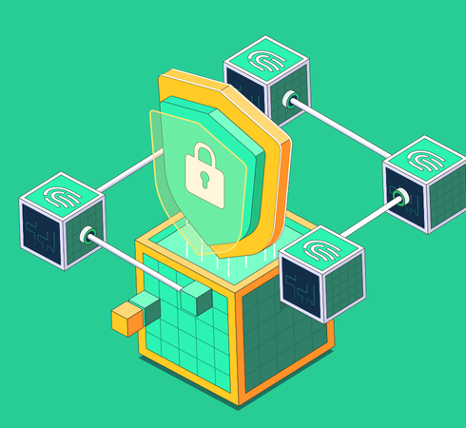
Security Framework
Smart Contracts:
The system is secured through multiple independent audits, formal verification of critical components, a generous bug bounty program offering over $1M in rewards, and time-locked upgrades with a mandatory 7-day delay to ensure transparency and community oversight.
Key Management:
Administrative control is protected by a 3-of-5 multi-signature scheme, issuer funds are safeguarded using MPC-based custody, and assets are secured in hardware wallet storage to minimize single points of failure.

Slide 13
01
02
03
Data Privacy
On-Chain
Never On-Chain
Verification Flow
Only non-sensitive information is recorded on-chain, including token balances, a boolean allowlist status, and encoded attributes. This ensures transparency and verifiability while minimizing exposure of user information.
All personally identifiable and sensitive data—such as names, email addresses, government IDs, and financial details—is strictly kept off-chain. This data is handled exclusively by trusted KYC providers and never written to the blockchain.
The compliance process follows a privacy-first flow: user data is verified by a KYC provider, the result is encrypted, the allowlist is updated accordingly, and only the final compliance status is reflected on-chain.

Slide 14
Risks & Challenges
Security Risks : Critical threats like smart contract exploits and key compromises require top priority. We address these through multiple audits, bug bounties, and formal verification to protect funds and platform integrity.
Regulatory & Compliance : Evolving global securities and AML laws demand constant attention. We build flexible compliance systems and work with legal experts to ensure lawful operations across jurisdictions.
50%
30%
Market & Adoption : Our biggest challenge is attracting issuers and investors to build liquidity. Success depends on strategic partnerships,and bridging traditional and digital finance.
Technical Scalability : Long-term growth requires planning for transaction volume and cost. We prioritize Layer 2 readiness and gas optimization, which are manageable with existing solutions.
80%
10%

Slide 15
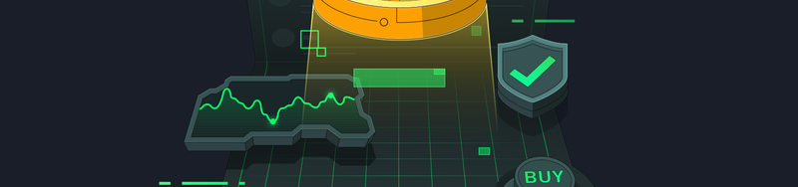
Queries ?

Slide 16

Thank You !

